Slide 1
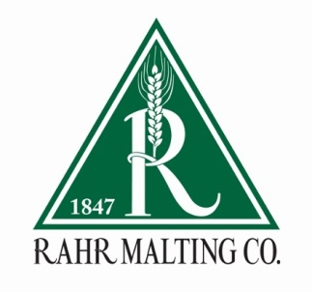
Malting 101
The foundation and building blocks of malting.

Slide 2
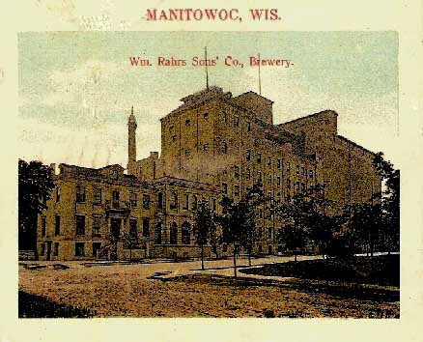
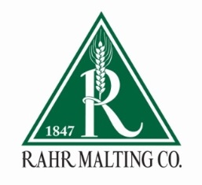
Rahr Malting History
Founded in Manitowoc, WI in 1847
  It began as a brewery supplying William Rahr’s Eagle Brewery Lager
  After establishing the brewery he built a malthouse and began supplying other local breweries
After an incident with a brew kettle ended William Rahr’s life, the three sons eventually incorporated to form William Rahr’s Sons.
During prohibition the brewery shut down never to re-open.
The Rahr’s began selling malt to Anheuser-Busch as early as 1891 and eventually sold the facility to them in 1962

Slide 3
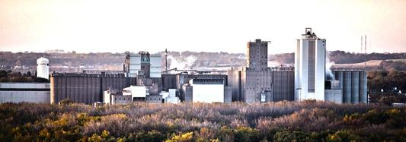
Rahr Shakopee
The Shakopee location has six malthouses. Four of which are Saladin design, one tower, and one Saladin/tower hybrid.
    The malthouses were built in 1936, 1952, 1975, 1980, 1994, and 2016.
Shakopee is currently the largest single-site malting facility in the world.
Yearly production is approximately 420,000 MT (28 million bushels) of finished malt.

Slide 4
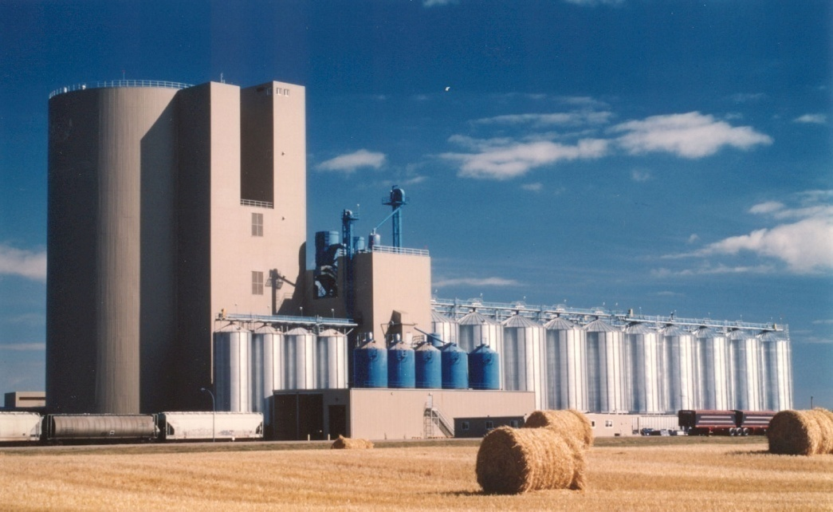
Rahr Alix, Alberta
Construction was completed in 1992
It is a Norden-style tower malthouse
Current yearly production is approximately 140,000 MT (9 million bushels) of finished malt

Slide 5

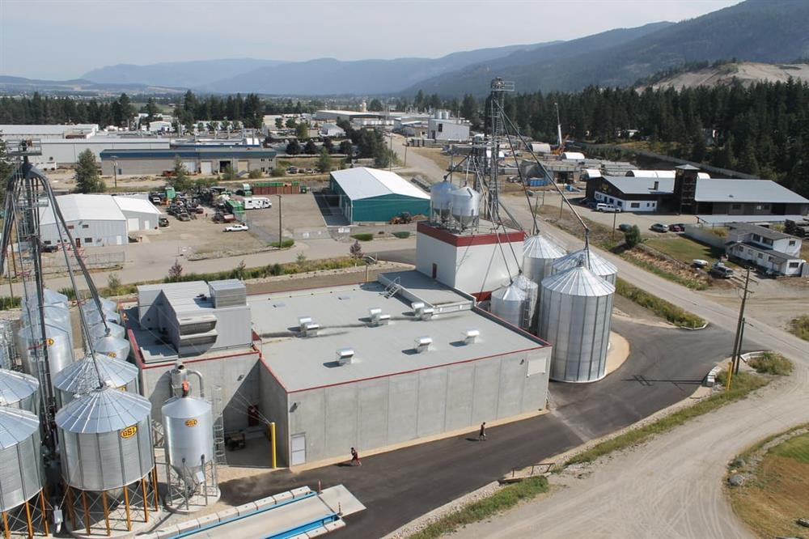
Purchased by Rahr Corp. in February of 2017
Two saladin malthouses
Current yearly production is approximately 12,000 MT of finished malt
Well developed product offering including, but not limited too, Pale, Vienna, Munich, and Honey Malt.

Slide 6
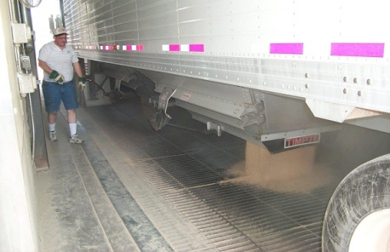
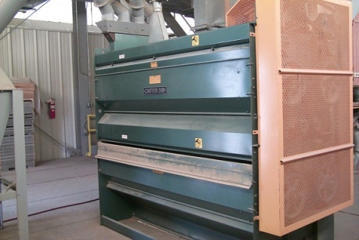
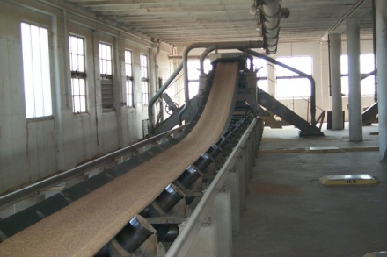
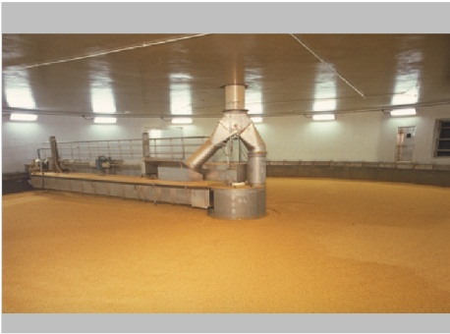
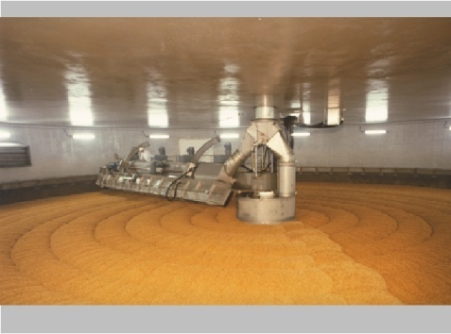
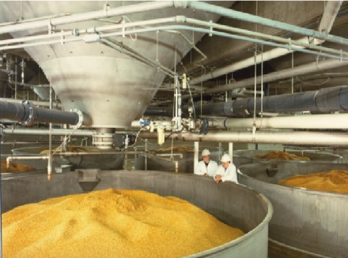
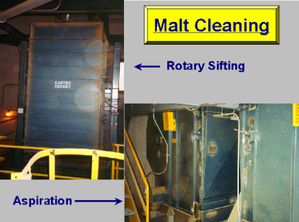
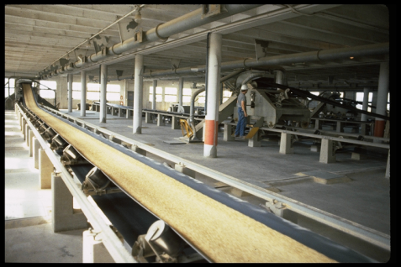
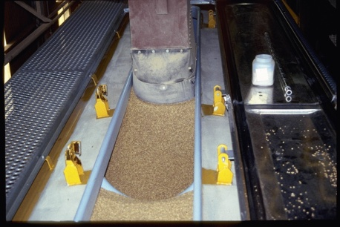
Malting Operation
Barley Unloading
Cleaning & Grading
Transfer to Silo
Kilning
Germination
Steeping
Malt Cleaning
Transfer to Silo
Loading Malt

Slide 7
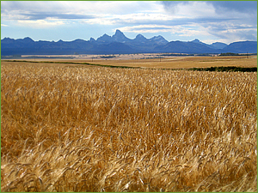
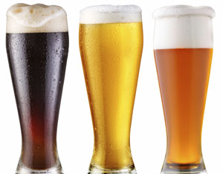
Barley
Why barley?
  Starch that is converted to sugar during the malting and brewing process
  Enzymes convert starches to sugar and proteins to amino acids
  Husk provides a filter bed
  Yeast nutrients such as vitamins, minerals, and amino acids
  Provides aroma, flavor, color, and foam potential to the beer

Slide 8
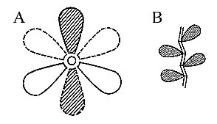
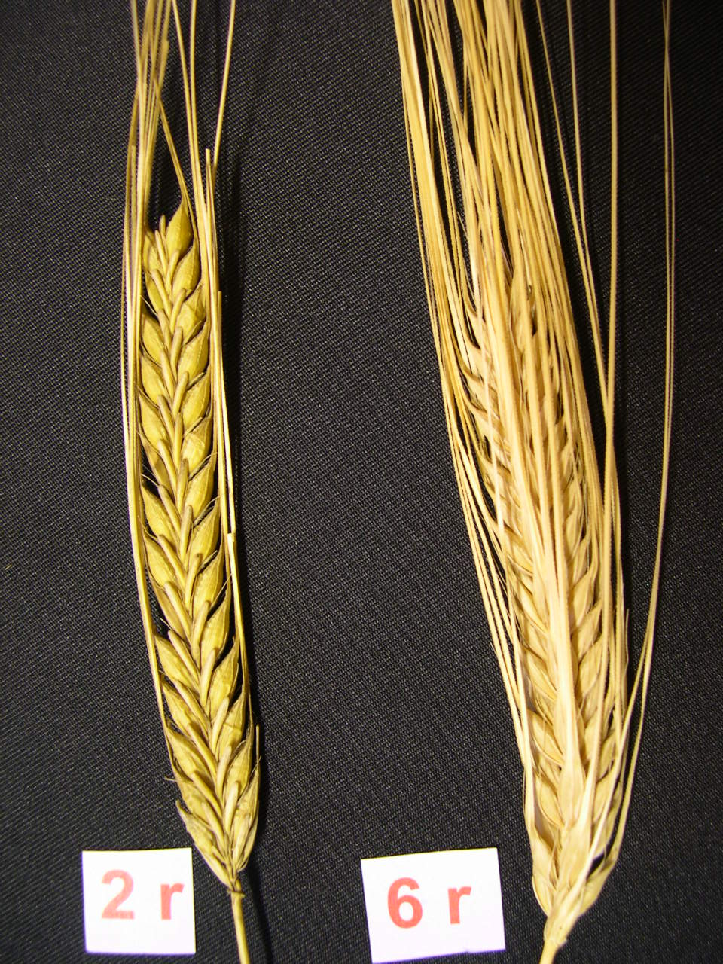
Barley Varieties
2-row barley
  Lower Protein
  Lower Enzymes
  Higher Extract
6-row barley
  Higher Protein
  Higher Enzyme Package
  Lower Extract

Slide 9
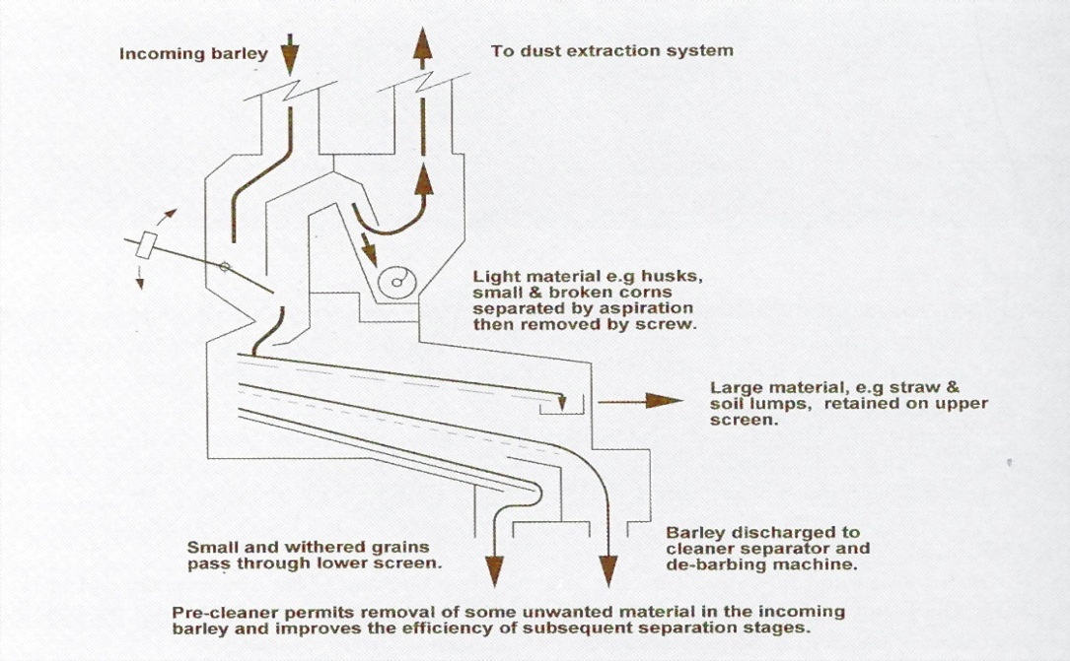
Barley Cleaning
Purpose of barley cleaning is to remove any impurities
  Lighter than barley (Aspirator)
  Larger or longer than barley (Scalper)
  Metallic Compounds (Magnet)
  Heavy objects and stones (Gravity)

Slide 10
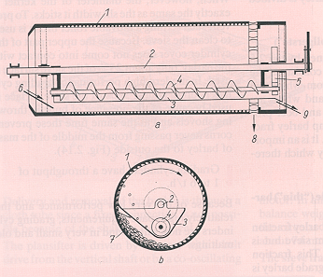
Barley Grading
Grading barley is the process of separation based on kernel width/plumpness
Purpose of grading
  Customer specification
  The plumpness of the kernel will have a direct impact on how it is processed during malting
Barley Grades
  A - on 6.25/64” – brewers
  B - on 5.5/64” – brewers
  C - on 5.25/64” – brewers/dist.
  D – on 5/64” – dist. or feed
  Thrus – thru 5/64” - feed

Slide 11
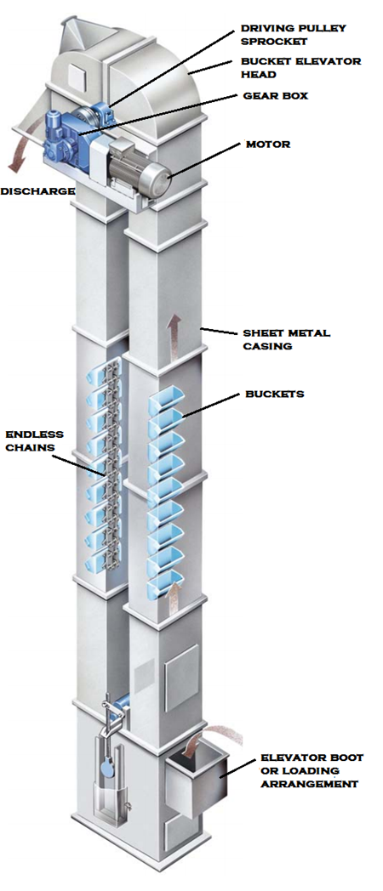

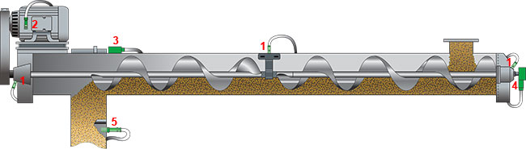
Transfer of Barley and Malt
Mechanical Transportation
  Screw Conveyor
  Chain/Drag Conveyor
  Belt Conveyor
  Bucket Conveyor

Slide 12
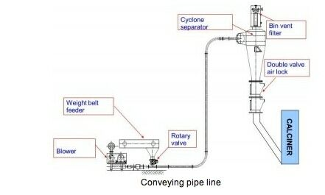
Transfer of Barley and Malt
Pneumatic Transportation
  Suction Conveyor
  Compressed Air Conveyor

Slide 13
Barley Storage
Segregation Criteria
  Variety/Year
  Grades
  Protein Level
  DON Level
  Growing Region
  Brightness
Pest Control
  Inspect incoming barley
  Clean silos before filling
  Fumigate silos
  Inspect Conveyors
  Good Housekeeping
Rahr Shakopee Storage
6.5 million bushels of total storage
273 Individual bins
Approximately 12-15 different barley varieties at any time

Slide 14

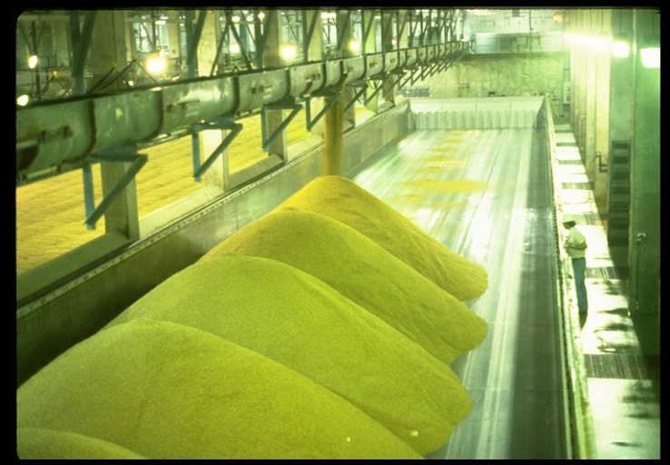

Malting Process
What is Malting?
  Malting is a controlled germination of a cereal grain to produce enzymes and to cause defined changes in its chemical constituents
Steeping
36-48 Hours
Germination
96-120 Hours
Kilning
24-48 Hours

Slide 15
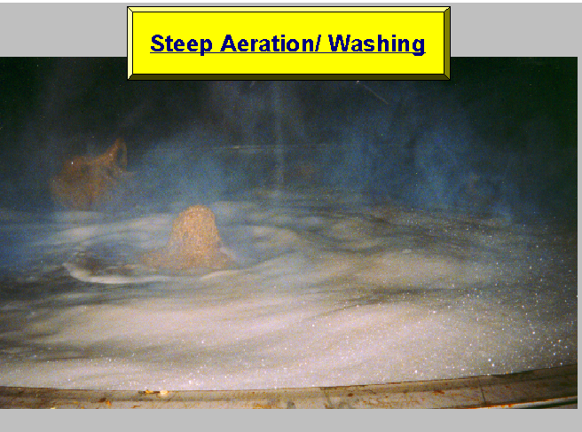
Steeping
Steeping is the most critical stage of the malting process
Objectives of steeping
  Clean and rinse barley surface
  Remove growth inhibitors
  Hydrate the barley kernals
  Provide O₂ and remove CO₂
  Control temperature to ensure uniform respiration
Steeping Control Parameters
  Hydrate barley t
  Water temperature 48-70 ⁰F
  CO₂ removal

Slide 16
Typical Immersion Schedule
O₂
Water
CO₂
Air
Rest
CO₂
Air
Rest
O₂
Water
CO₂
Air
Rest
O₂
Water
CO₂
Air
Rest
O₂
Water
Four water phases followed by four air rest phases
Vigorous Aeration in water phase
Consistent CO₂ removal during dry air rest

Slide 17
Water Uptake vs. Kernel Size
50
small
40
medium
% Moisture
30
large
avg..all
20
10
0
10
20
30
40
50
60
Time (Hrs.)

Slide 18
Conical Steeping Vessels
  Smaller batch sizes
  Lower water usage
  Deeper tanks may have issues with hydrostatic pressure
  Wider steep tanks may have issues with uneven aeration and CO₂ removal
  Smaller tanks have more uniform aeration and CO₂ removal
High Volume Deep
High Volume Wide
Low Volume

Slide 19
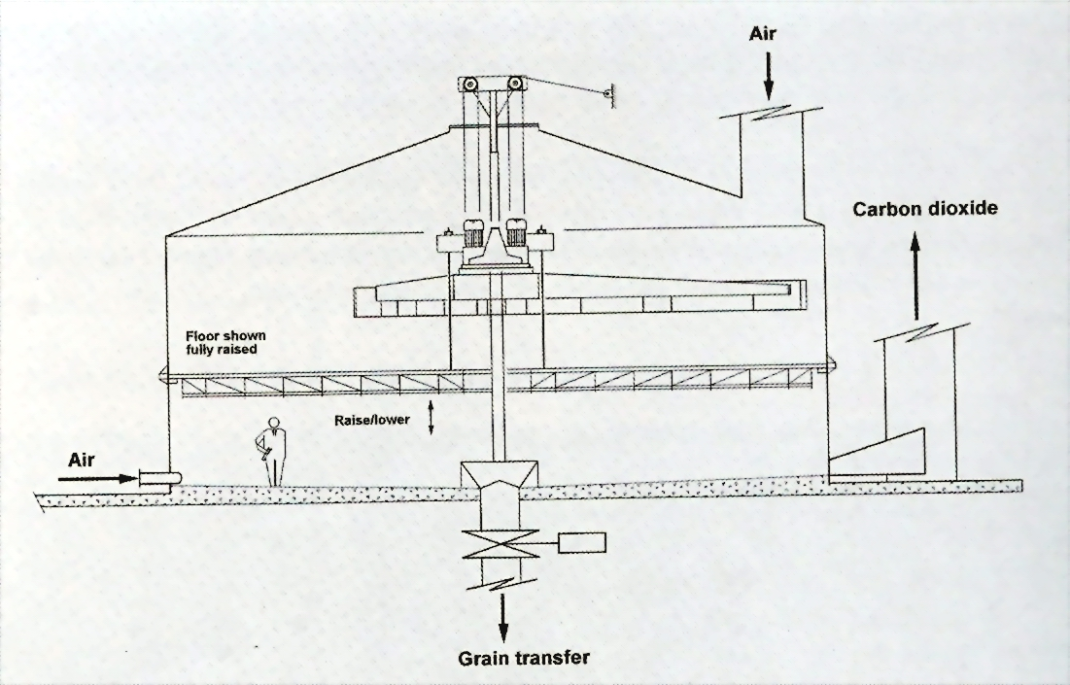
Flat Bottom Steeping Vessels
Flat bottom steeps are typically designed for larger production pieces
Flat bottom steeps typically have a higher water usage due to the false bottom
Flat bottom steeps have better airflow and more uniform CO₂ removal

Slide 20
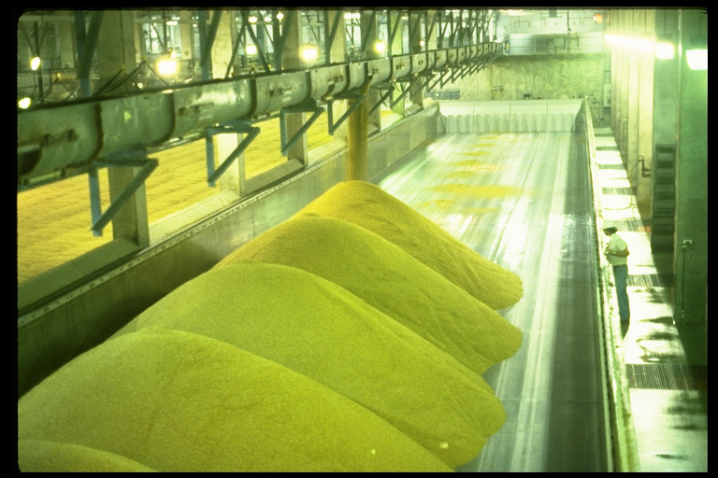
Germination
The controlled growth of barley to promote the activation of the enzymatic pathways to well-modified green malt.

Slide 21
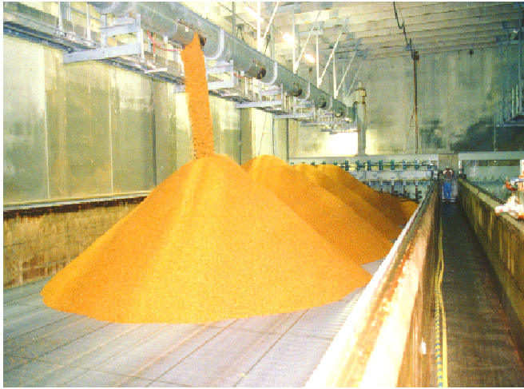
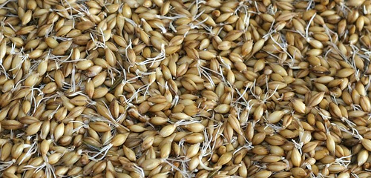
Germination
Rootlets will begin to form
Acrospires will begin their growth from the embryo
Objectives
  Produce optimal level of hydrolytic enzymes
  Control adequate modification
  Produce balanced, homogenous, green malt

Slide 22
Factors Impacting Germination
Germination Time
  Varietal dependent
Germination Temperature
  Warmer: higher growth rate and respiration -> higher malting loss
  Cooler: potentially slower modification -> lower malting loss
Moisture Content
  Typically runs at 46-48%
  Increased moisture: higher growth rate and enzyme formation. Higher malt loss and longer kiln times.

Slide 23
Germination Control Parameters
Germination Time
  Variety basis. Typically 3.5-5 days
Air on or house temperature
  Typically 54-60⁰F
Air off or exhaust temperature
  Typically 68-72⁰F
Airflow
  No limit to oxygen intake and we must maintain temperature control.
Water additions
  Volume and timing
Machine Runs
  Frequency and timing relative to variety

Slide 24
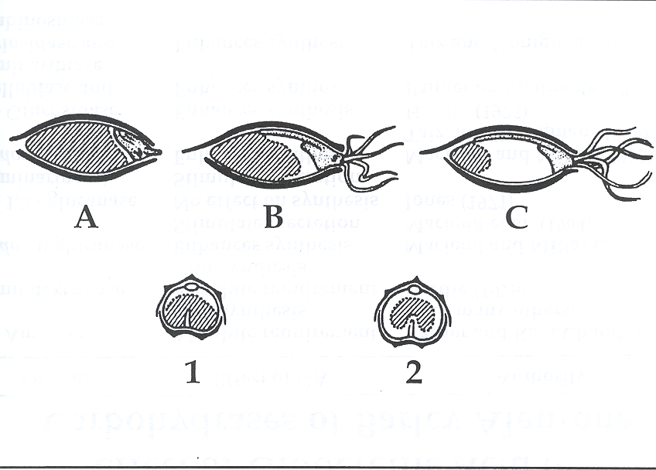
Malt Modification

Slide 25
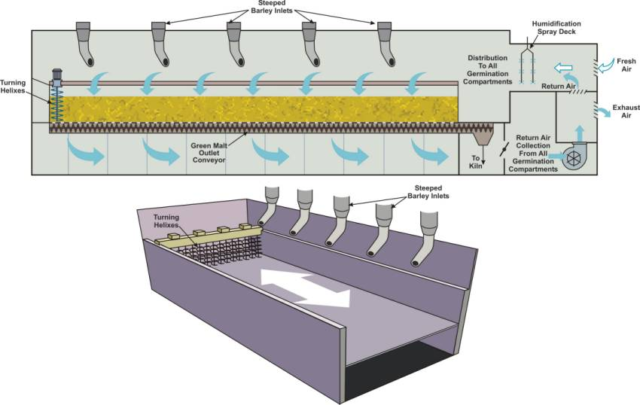
Saladin Style Malting

Slide 26
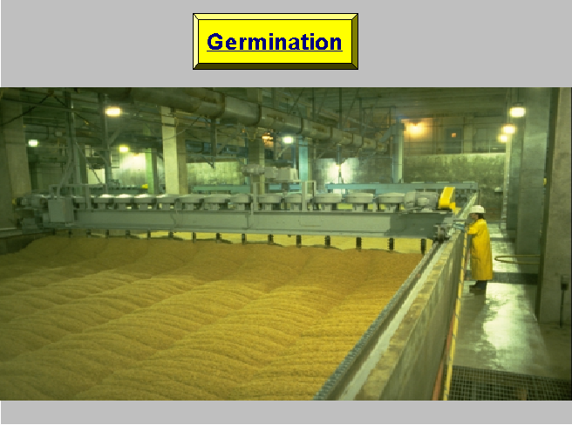
Saladin Style Malting

Slide 27
Tower Malting
Tower malting is the most modern malt house method
The process begins at the top of the malthouse and each part of the process is transferred downward as each portion is stacked on itself
Uses the same malting process as rectangular (Saladin) design malthouses
Maximum use of gravity for transfers and reduces the use of conveyors for grain movement
This design requires the least amount of space for construction

Slide 29
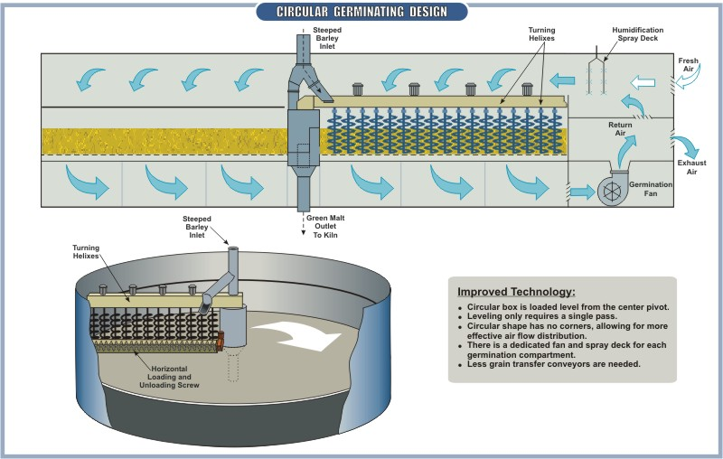
Circular Germination Vessel

Slide 30

Circular Germination Vessel

Slide 31
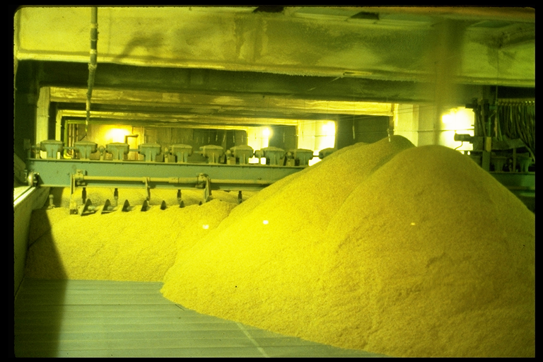
Kilning
What is it?
  High volume of heater air is passed through the grain bed to evaporate moisture to a level where bio-chemical activity is terminated

Slide 32
Objectives of Kilning
Arrest biochemical reactions and stabilize enzymatic activity
Develop color, aroma, and flavor
Make the malt crisp and friable for milling
Reduce moisture for storage stability
  Typically go to kiln at 46-48% moisture and reduce it to 4-5%

Slide 33
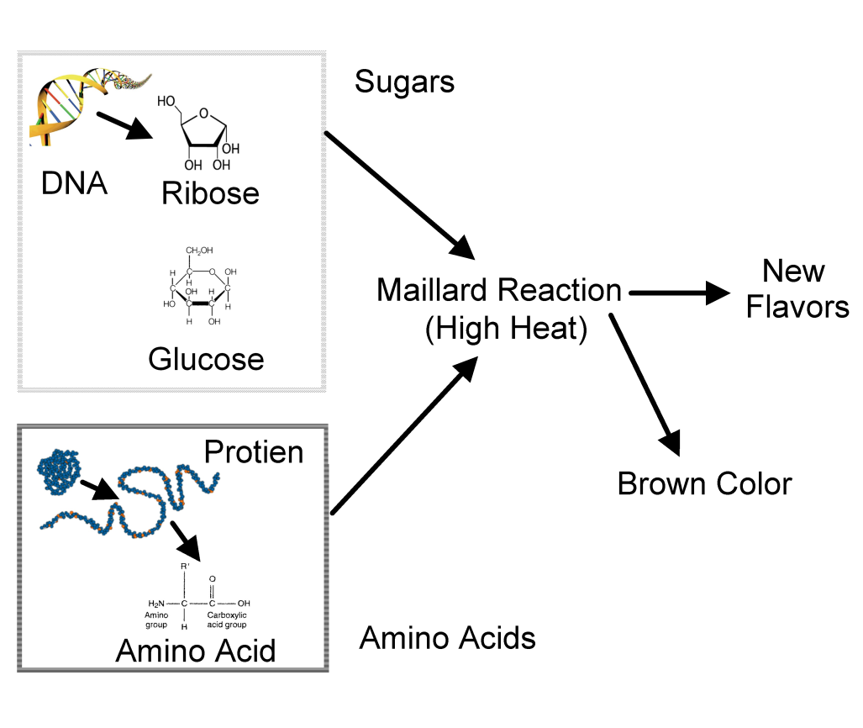
Chemical Changes during kiln
Maillard Reaction
  Same reaction which causes bread to brown and smell good
  Melanoidins form color
  Maltol (which is where “malt” gets its name) and isomaltol form aroma compounds
*In the presence of moisture*

Slide 34
Phases of kilning
Germination Phase - Free drying
  Germination continues and is even expedited
  Moisture is lost rapidly
Enzymatic Phase - Breaking phase
  Embryo slows or dies
  Hydrolytic products accumulate
  Break point – air off the bed drops below 100% humidity and the exhaust temperatures begin to increase
Chemical Phase - Curing
  Melanoidin formation
  Caramelized sugars
  Oxidized polyphenols
  No more free drying, higher heats are used to force the remaining moisture out of the kernel

Slide 35
Malt Changes during kilning
Phase 1
Phase 2
Phase 3

Slide 36
Types of Kilns
Single Deck
  Separate Structure (Rectangular or Circular)
  Fleximalt (Used for both Germ and Kiln)
Double Deck
Modified Double Deck
Roasting

Slide 37
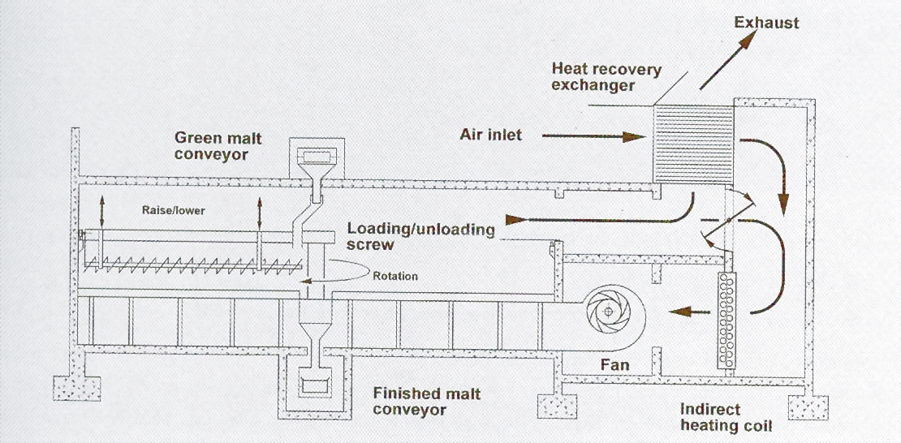
Single Deck

Slide 38
Single Deck Round

Slide 39
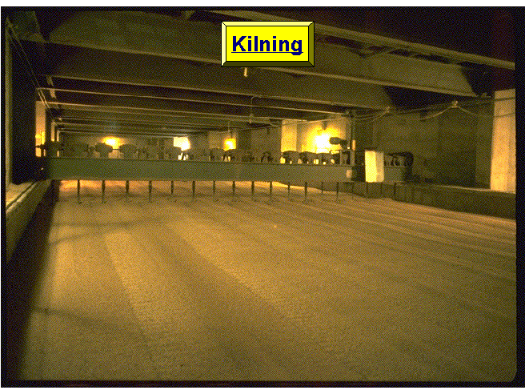
Double Deck Rectangular Kiln
Exhaust heat from the lower bed is used to dry the upper deck
The trays typically have the ability to dump the malt to either the Sau or the lower deck.

Slide 40
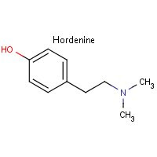
NDMA
N-Nitrosodimethylamine
  Suspected carcinogenic compound
  NDMA is formed when amines (found in the malt) react with nitrogen oxides (NO_{x}) found in the kiln gases
  Hordenine is a major precursor which is found in the barley roots
+
No_{x}
=
NDMA

Slide 41
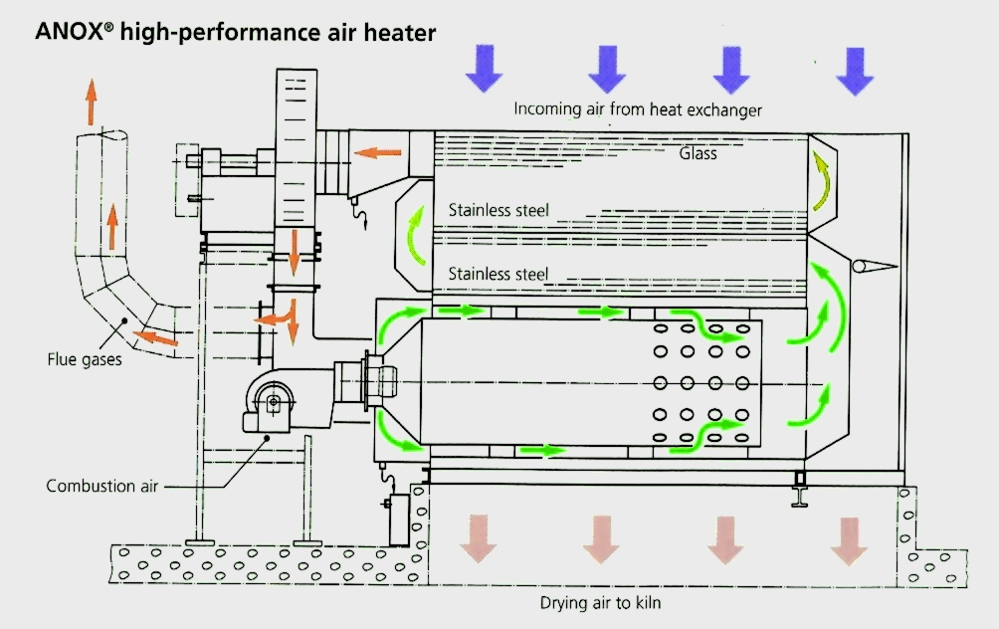
Control of NDMA
Indirect kilning through a heat exchanger
Addition of sulfur prior to kilning

Slide 42
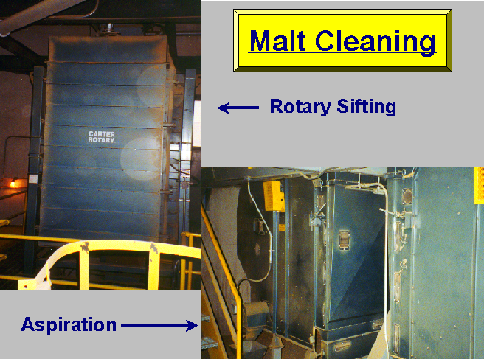
Malt Storage, Cleaning and Dispatch
Malt will be cleaned (De-Culmed) on its way from the malthouse to the bin
  This is to remove rootlets and acrospires
  Clean out any dust before storage

Slide 43
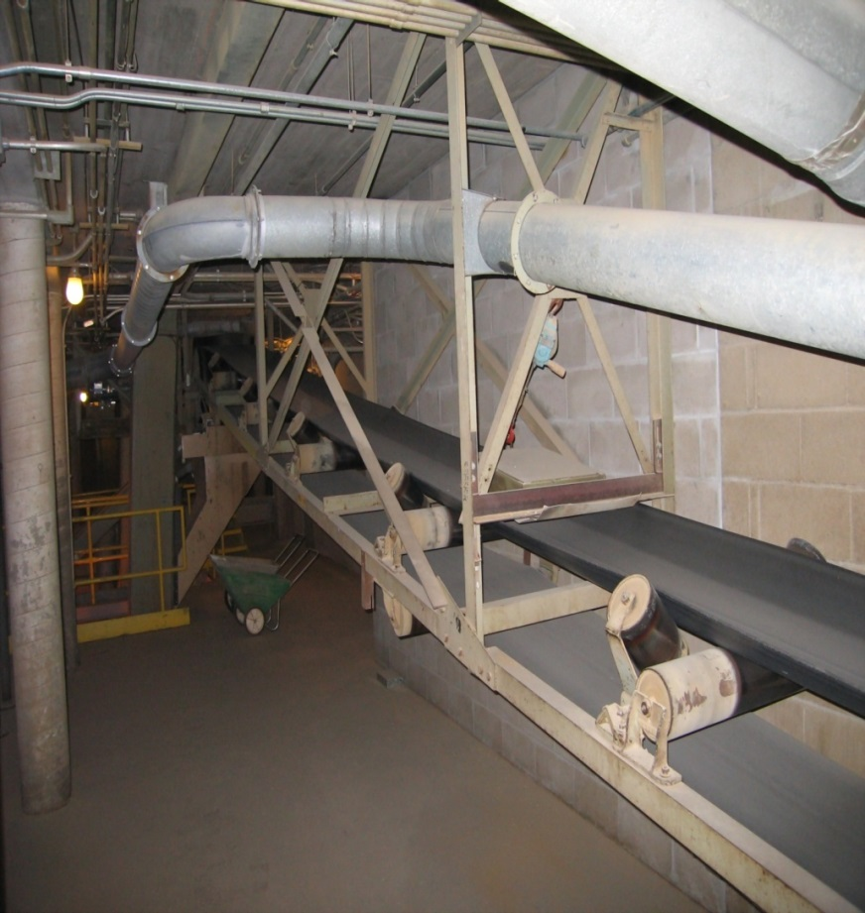
Malt Storage, Cleaning, and Dispatch
All general barley handling rules apply
Prevent Breakage
  Proper cooling at the end of kiln
  Malt aging
  Use gentle de-culming
  Low speed conveyors
  Minimize the number of elevations
  Use choke (velocity breakers) in free fall areas
*Belt conveyors provide one of the softest forms of malt handling*

Slide 44
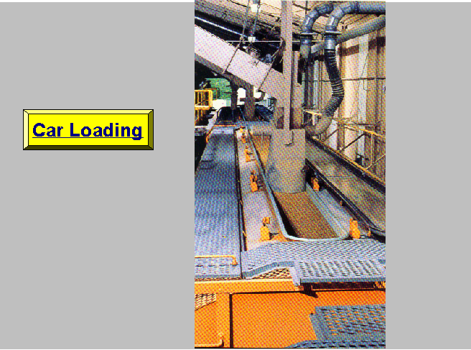

Slide 45
Floor Malting
Original method of malting
Labor intensive
Small batch size
Steeped barley laid on tile or concrete floors – 6 to 12” deep
No air flow through the germinating barley
Room temperature controlled by windows on the outside walls
Turned with wooden shovels/rakes to reduce heat build up and to aerate

Slide 46
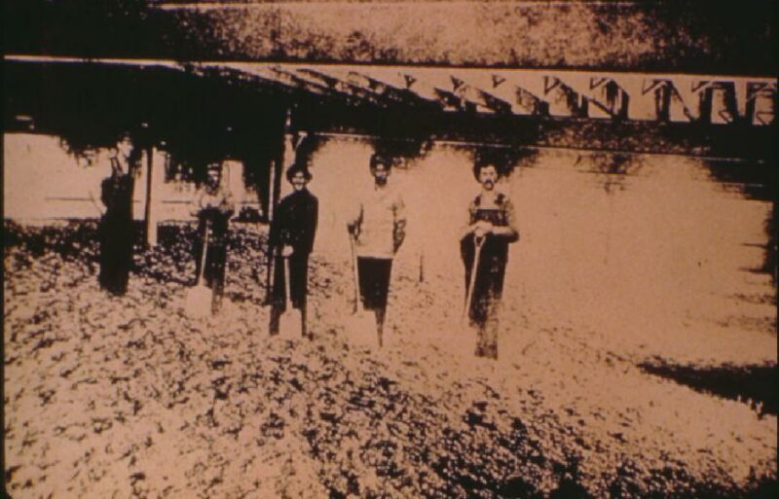
Thank you for your time.
Questions?

