Slide 1
The Evolution of West Coast IPA: What’s Changed, What Matters, and How You Can Leverage Data To Create Modern West Coast IPA’s
MBAA New England Spring Technical Meeting- May 2026

Slide 2
Agenda
1
Classic West Coast IPA
2
Modern West Coast IPA
3
Award Winning Modern West Coast IPA Survey Results
4
Putting It All Together

Slide 3
Classic West Coast IPA
Section 1

Slide 4
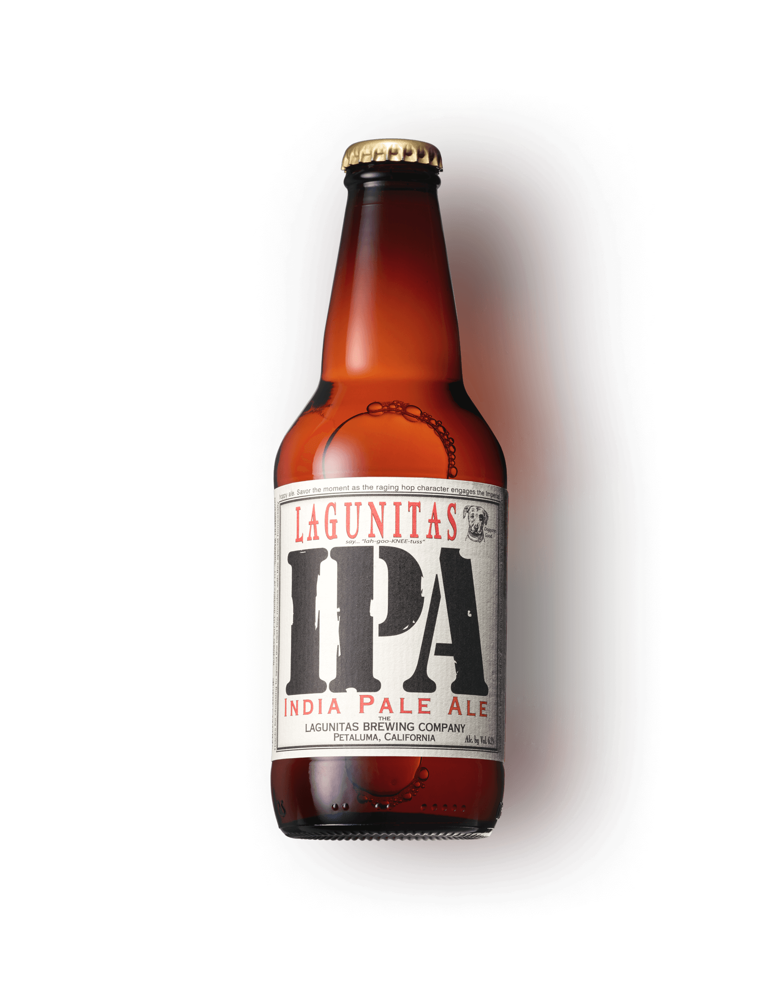
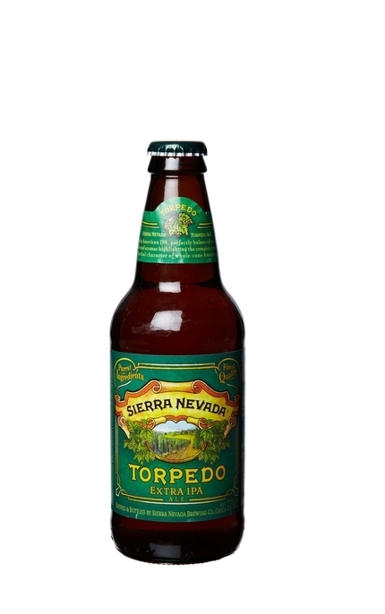
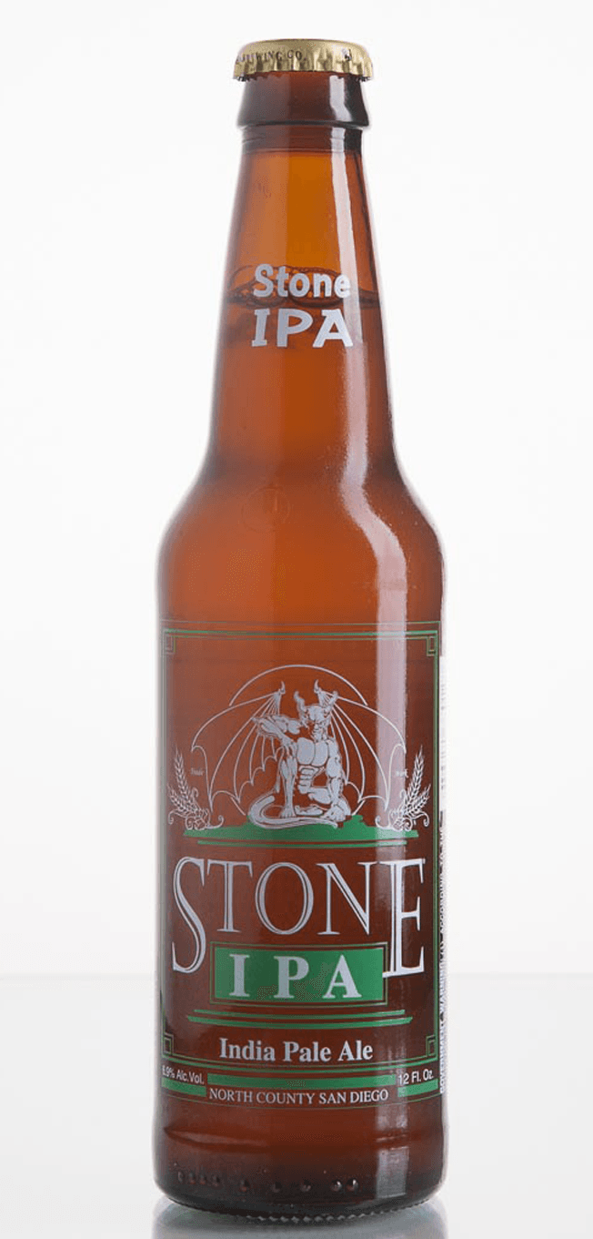
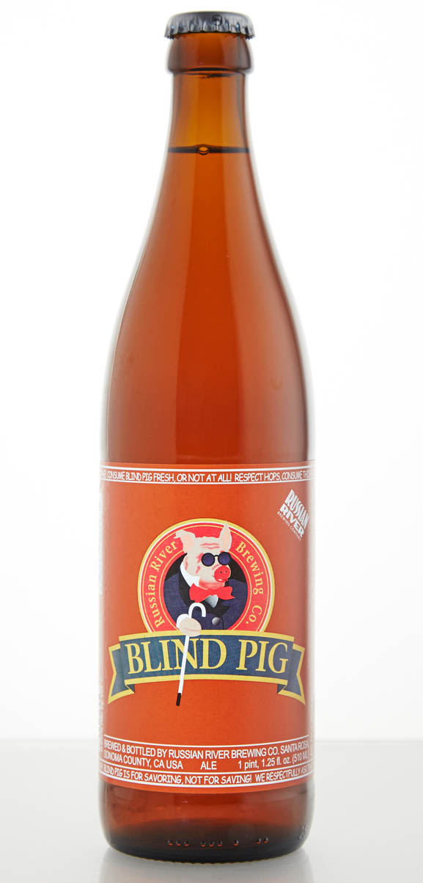
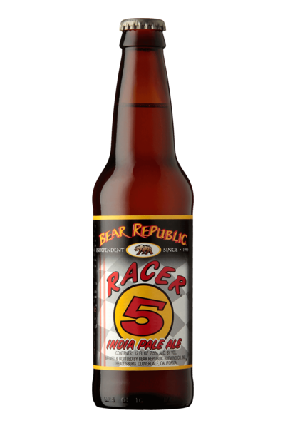
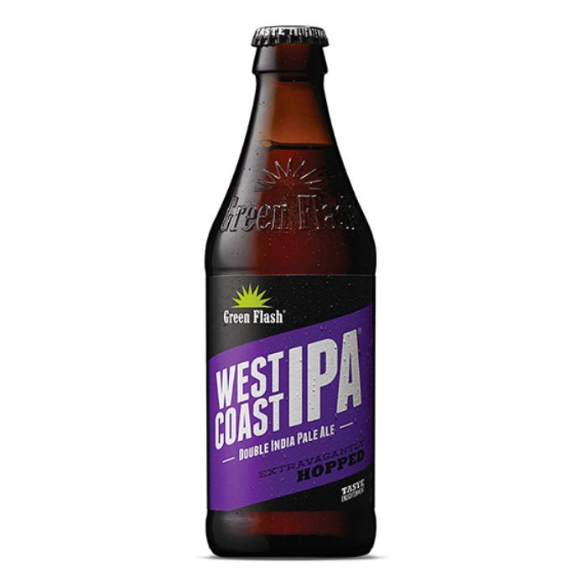
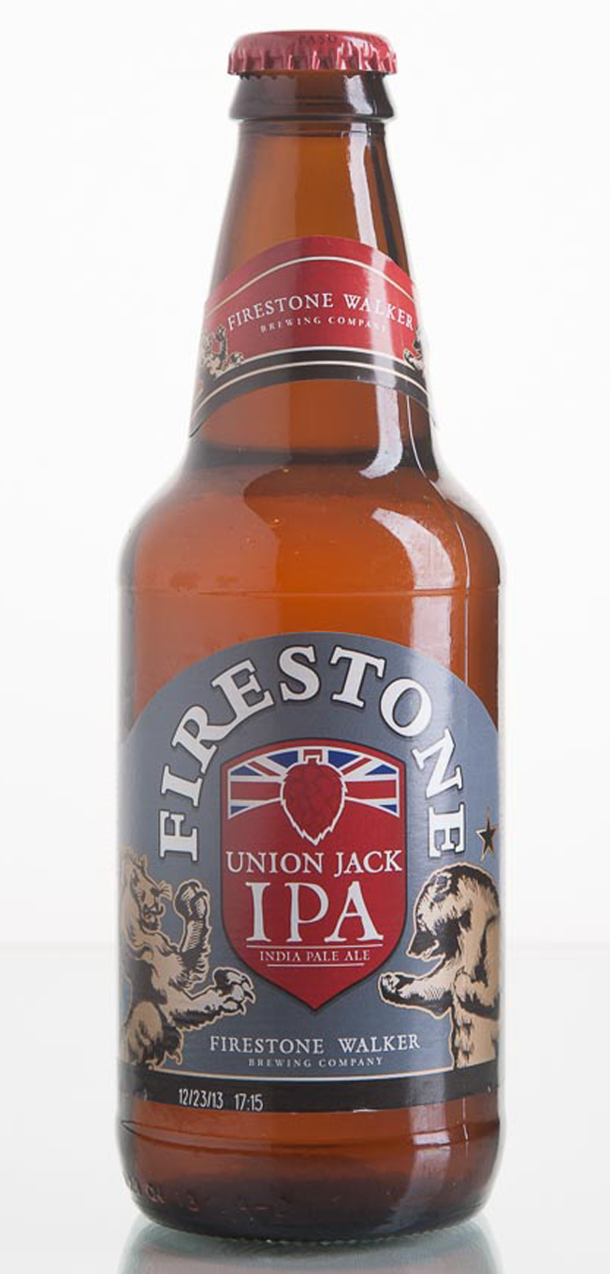
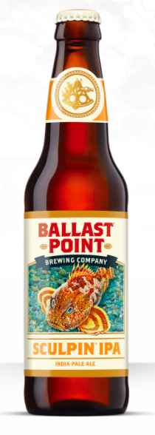
When you think about classic west coast IPA, what comes to mind?
CRYSTAL MALT
“C” HOPS

Slide 5
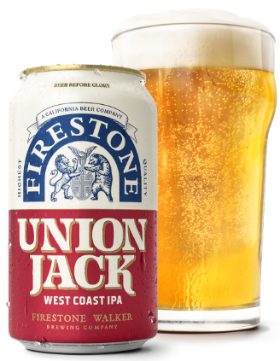
Key Attributes of Classic West Coast IPA
Color
Pale ────────► Copper
Clarity
  Chill Haze & Hop Haze: Acceptable
Malt Aroma & Flavor
Medium‑Low ──► Medium
Body
Medium- Low ──────────► Medium
OG: 14.7- 17.1oP
FG: 2.5- 4.1oP
ABV: 6.3%- 7.5%
SRM: 4 - 12
7.0% ABV/ 8.5 SRM

Slide 6
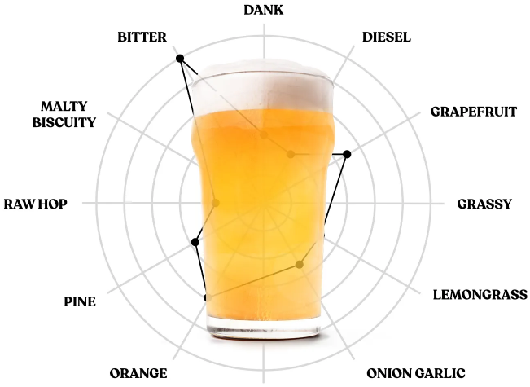
Key Attributes of Classic West Coast IPA
Hop Aroma & Flavor
High ─────────► Very High
Bitterness
Medium‑High ───────► Very High
IBU: 50 – 70
Fermentation Characteristics
Fruity Ester Low ─────► High
DMS: ✗ Diacetyl: ✗

Slide 7
Commercial Examples in 2012
Beer Description | OG | FG | ABV | IBU | SRM
World Beer Cup Gold | 15.0 | 2.4 | 6.7% | 60.5 | 7.3
World Beer Cup Gold | 16.5 | 3.7 | 7.0% | 70.0 | 9.2
GABF Gold | 17.7 | 3.7 | 7.4% | 61.8 | 8.7
GABF Gold | 16.5 | 3.0 | 7.5% | 75.0 | 8.0
National Brand | 17.0 | 3.4 | 7.5% | 87.0 | 8.5
National Brand | 14.6 | 3.1 | 6.2% | 51.0 | 8.7
National Brand | 16.0 | 2.9 | 6.9% | 75.0 | 9.5
National Brand | 16.9 | 3.7 | 7.2% | 65.0 | 10.0
AVERAGE | 16.3 | 3.2 | 7.0% | 68.0 | 8.7

Slide 8
Commercial Examples in 2012
Beer Description | Grain Bill | Hops | Yeast
World Beer Cup Gold | 2-Row, C-40, Dextrin | AMA, CEN, CAS, CHI, SIM | Chico
World Beer Cup Gold | 2-Row, C-10, Caravienne, Dextrin | MAG, CTZ, WAR, AMA, SIM, CEN | Chico
GABF Gold | 2-Row, C-15, Wheat, Dextrin, Dextrose | CHI, CAS, CEN, CTZ | Liberty
GABF Gold | 2-Row, Munich, C-40, Dextrin | MAG, WAR, CTZ, CAS, CEN, AMA, SIM | Chico
National Brand | 2-Row, Maris Otter, C-10, C-40, Wheat, Dextrin, Dextrose | CEN, CTZ, SIM, CIT | Chico
National Brand | 2-Row, Munich, C-15 | CAS, CEN, CHI, SIM | Chico
National Brand | 2-Row, C-15 | CHI, CTZ, CEN | Chico
National Brand | 2-Row, C-60 | MAG, CRY, CIT | Chico
Most Common Ingredient | 2-Row, C-10-60, Dextrin | Centennial, Simcoe, CTZ, Cascade, Chinook | Chico

Slide 9
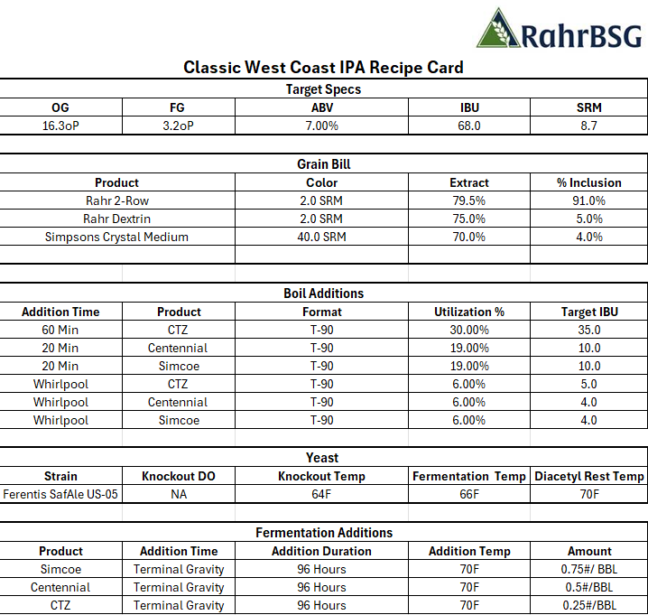
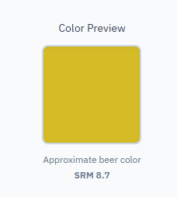
Classic West Coast IPA Example
OG: 16.3
FG: 3.2
ABV: 7.0%
IBU: 68.0
SRM: 8.7
Grain Bill: 2-Row, Dextrin, C-40
Hops: Centennial, Simcoe, CTZ
Yeast: Chico Ale

Slide 10
Modern West Coast IPA
Section 2

Slide 11
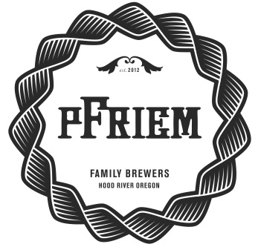

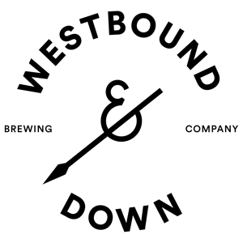




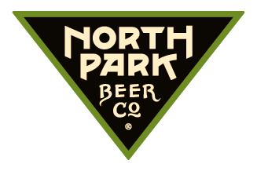


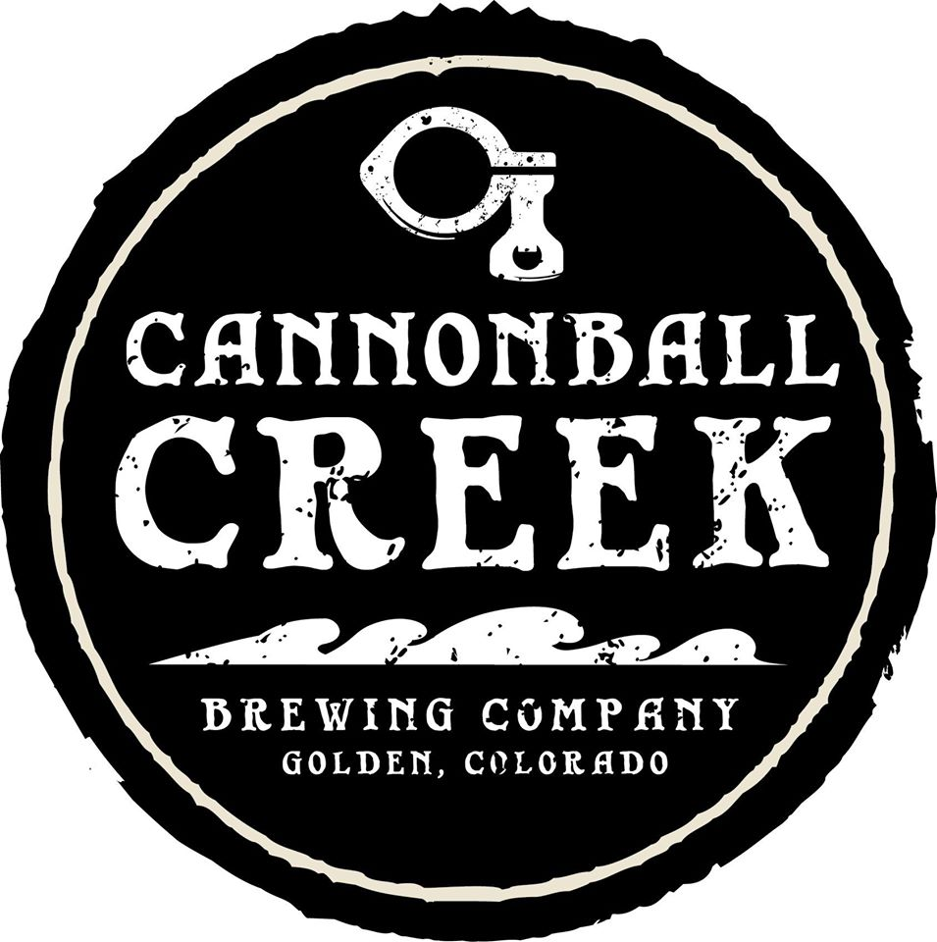
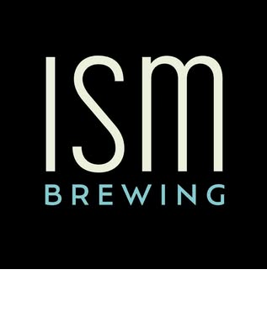
When you think about Modern West Coast IPA, What Comes to Mind?
HOP SATURATED
DRY
PALE
CLEAR
CRISP
TROPICAL
FRUITY
DANK
FIRM BITTERNESS
AROMATIC
HIGH DRINKABILITY

Slide 12
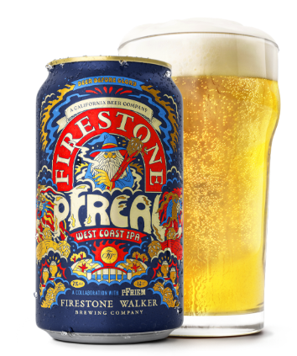
Key Attributes of Modern West Coast IPA
Color
Straw ───────► Gold
Appearance
Chill Haze & Hop Haze: Acceptable if LOW
Malt Aroma & Flavor
Low ────────►Medium‑Low
Caramel: ✗ Roasted Malt: ✗
Body
Low ──────────► Medium‑Low
Attenuation: High (defining trait)
OG: 13.5- 17.1oP
FG: 1.5- 3.0oP
ABV: 6.3% - 7.5%
SRM: 2 - 6
7.0% ABV/ 4.1 SRM

Slide 13
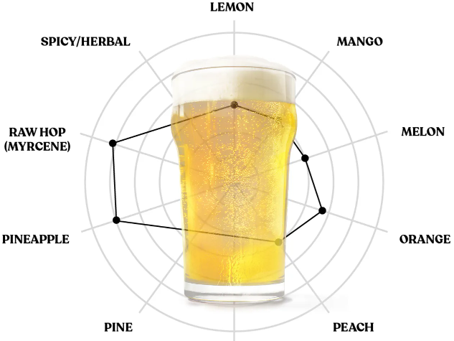
Key Attributes of Modern West Coast IPA
Hop Aroma & Flavor
High ────────► Very High
Bitterness
Medium‑High ──► Very High (NOT Harsh)
IBU: 50 - 75
Fermentation Characteristics
Fruity Ester Low ─► Medium
DMS: ✗ Acetaldehyde: ✗ Diacetyl: ✗

Slide 14
What Expectations Changed?
Color: Lighter
Clarity: Less room for chill or hop haze
Malt Aroma & Flavor: Caramel/ Roasted Malt Character no longer acceptable
Body: Less body
Hop Aroma & Flavor: Same- however more acceptance of new hop variety aroma & flavor
Bitterness: Similar IBU expectation, however emphasis is placed on it being less harsh
Fermentation Character: Looking for clean fermentations with minimal esters or off flavors. Emphasizing the high attenuation/ dryness.

Slide 15
Modern West Coast IPA Survey
Section 3

Slide 16
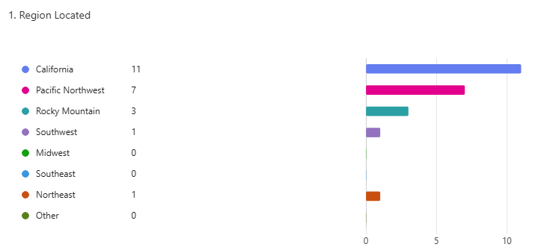
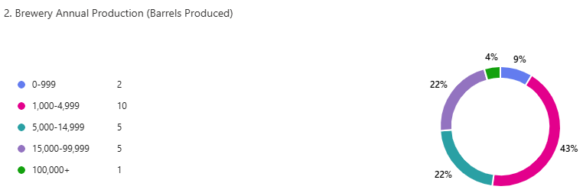
Surveyed Group
30 Breweries Surveyed
All have won a medal at GABF or WBC between 2023-2026 in one of the following categories:
  American- Style India Pale Ale
  West Coast-Style India Pale Ale
  American-Style Strong Pale Ale
  Imperial-Style India Pale Ale
23 Responses (~77% Response Rate)
20 Technical Oriented Questions, 5 Brewery Related Questions

Slide 17
West Coast-Style IPA Winner Specs
Competition | OG | FG | ABV | IBU | SRM
GABF Gold | 15.0 | 2.0 | 7.0% | 70.0 | 2.0
GABF Gold | 14.1 | 1.6 | 6.7% | 55.0 | 3.5
World Beer Cup Gold | 14.2 | 1.4 | 6.9% | 78.0 | 3.1
World Beer Cup Silver | 14.2 | 1.3 | 7.0% | 100.0 | 2.0
World Beer Cup Silver | 15.1 | 1.6 | 7.4% | 80.0 | 4.0
World Beer Cup Silver | 14.4 | 1.7 | 7.0% | 67.0 | 3.8
GABF Bronze | 15.2 | 2.0 | 7.2% | 45.0 | 3.5
World Beer Cup Bronze | 15.0 | 1.8 | 7.0% | 52.0 | 4.4
AVERAGE | 14.7 | 1.7 | 7.0% | 68.0 | 3.3

Slide 18
West Coast-Style IPA Winner Ingredients
Beer Description | Grain Bill | Hops | Yeast
GABF Gold | Pilsner, Malted Wheat, Dextrose, Flaked Oats | Mosaic, Simcoe, CTZ, Riwaka | Ale
GABF Gold | Pilsner, Flaked Rice, Malted Extra Pale Wheat, Dextrose, Acidulated | Mosaic, Citra, Simcoe | Ale
World Beer Cup Gold | Pilsner, Acidulated | Mosaic, Simcoe, Nectaron, Nelson Sauvin, CTZ | Ale
World Beer Cup Silver | Pilsner, 2-Row, Malted Wheat | Mosaic, Strata, Nelson Sauvin | Ale
World Beer Cup Silver | Pilsner, Malted Wheat, Flaked Wheat, Flaked Rice | Mosaic, Simcoe | Ale
World Beer Cup Silver | Pilsner, Acidulated | Mosaic, Strata, Nelson Sauvin | Ale
GABF Bronze | Pilsner, Dextrose | Mosaic, Simcoe, Krush | Ale
World Beer Cup Bronze | Pilsner, Malted Wheat, Flaked Rice | Mosaic, Nelson Sauvin, Riwaka | Ale
Most Common Ingredient | Pilsner, Wheat, Dextrose | Mosaic, Simcoe, Nelson Sauvin, Citra, Krush, Riwaka, Strata, CTZ | Ale

Slide 19
West Coast-Style IPA Winner Hop Products
Beer Description | Hop Products
GABF Gold | T-90 Pellets, Cryo/Concentrated Pellets
GABF Gold | T‑90 Pellets, Cryo/Concentrated Pellets, CO₂ Hop Extract
World Beer Cup Gold | T‑90 Pellets, Cryo/Concentrated Pellets, CO₂ Hop Extract, Cold Side Flowable Extract
World Beer Cup Silver | T‑90 Pellets, Cryo/Concentrated Pellets, CO₂ Hop Extract, Hot Side Flowable Extract
World Beer Cup Silver | T‑90 Pellets, Cryo/Concentrated Pellets, CO₂ Hop Extract, Hot Side Flowable Extract
World Beer Cup Silver | T‑90 Pellets, Cryo/Concentrated Pellets, CO₂ Hop Extract
GABF Bronze | T‑90 Pellets, CO₂ Hop Extract, Hot Side Flowable Extract
World Beer Cup Bronze | T‑90 Pellets, Cryo/Concentrated Pellets
Most Common Products | T‑90 Pellets, Cryo/Concentrated Pellets, CO₂ Hop Extract, Hot Side Flowable Extract

Slide 20
West Coast-Style IPA Winner Hopping Amounts/ Timing
Beer Description | WP #/ BBL | DH #/BBL | Total #/BBL | Cool WP? | DH During Fermentation?
GABF Gold | 2.0+ | 4.0+ | 6.0+ | Yes | Yes
GABF Gold | 2.0+ | 2.0-3.0 | 4.0-5.0+ | Yes | No
World Beer Cup Gold | 0-1.0 | 4.0+ | 4.0-5.0+ | No | No
World Beer Cup Silver | 0-1.0 | 2.0-3.0 | 2.0-4.0 | Yes | No
World Beer Cup Silver | 1.0-2.0 | 2.0-3.0 | 3.0-5.0 | Yes | Yes
World Beer Cup Silver | 1.0-2.0 | 4.0+ | 5.0-6.0+ | Yes | No
GABF Bronze | 1.0-2.0 | 2.0-3.0 | 3.0-5.0 | Yes | No
World Beer Cup Bronze | 0-1.0 | 3.0-4.0 | 3.0-5.0 | Yes | Yes
AVERAGE | 1.0+ | 3.0+ | 4.0+ | Yes | No

Slide 21
West Coast-Style IPA Winner Process Aids
Beer Description | Process Aids
GABF Gold | Yeast Nutrient, Beta Glucan Reducing Enzyme, Diacetyl Reducing Enzyme, Anti‑Foam, Kettle Fining, Clarity Fining, Water Treatment Salts, pH Adjustment (Acids)
GABF Gold | Yeast Nutrient, Diacetyl Reducing Enzyme, Anti‑Foam, Kettle Fining, Clarity Fining, pH Adjustment (Acids)
World Beer Cup Gold | Diacetyl Reducing Enzyme, Anti‑Foam, Kettle Fining, Water Treatment Salts, pH Adjustment (Acids)
World Beer Cup Silver | Yeast Nutrient, Diacetyl Reducing Enzyme, Anti‑Foam, Kettle Fining, Water Treatment Salts, pH Adjustment (Acids)
World Beer Cup Silver | pH Adjustment (Acids), Water Treatment Salts, Clarity Fining, Yeast Nutrient, Kettle Fining
World Beer Cup Silver | Diacetyl Reducing Enzyme, Kettle Fining, Yeast Nutrient, pH Adjustment (Acids), Water Treatment Salts, Clarity Fining, Anti‑Foam
GABF Bronze | pH Adjustment (Acids), Water Treatment Salts, Clarity Fining
World Beer Cup Bronze | Yeast Nutrient, Diacetyl Reducing Enzyme, Clarity Fining, Kettle Fining, Beta Glucan Reducing Enzyme
Most Common Products | Ph Adjustment (Acids), Water Treatment Salts, Kettle Fining, Clarity Fining, Diacetyl Reducing Enzyme, Anti-Foam, Yeast Nutrient

Slide 22
How Survey Participants Described Modern West Coast IPA vs Classic West Coast IPA
Sensory Identity
  Bright, crisp, and highly drinkable
  Hop‑first, aroma‑driven
  Minimal malt distraction
  Fruit‑forward hop character
  Dry, snappy, clean finish
  “Pilsner‑like” base with IPA hop intensity
Brewing Technique/ Philosophy
  Keep it simple fewer ingredients, more intention.
  Let hops be the focus malt and yeast stay neutral.
  Aim for clarity modern WCIPA should be bright and crystal clear.
  Design for drinkability dry, crisp, saturated, and clean.

Slide 23
Key Tips from Survey Participants
Water Chemistry
  Water treatment is essential prevents “flabby” hop character.
  Lean into Sulfates to emphasize a sharp, clean bitterness. (2.5–3:1 Sulfate to Chloride typical)
  Be obsessive about pH finishing pH 4.3–4.4 recommended.
  Sodium can help balance dryness especially when FG is extremely low.
Oxygen Control & Cellaring
  Ultra‑low dissolved oxygen “can’t be too low.”
  Purge brite tanks effectively target <15 ppb O₂.
  Refine cellar practices hop removal, transfers, and cold‑side handling dramatically affect quality.
  Carbonation level helps target 2.65–2.8 vols for brightness.
Fermentation & Yeast Management
  Choose an appropriate yeast strain. Warm 34/70 for neutral profile and maximum attenuation. Added benefit of bound thiol release. Cool Chico fermentation for clean/ neutral profile and showcasing hops as they are.
  Prioritize yeast health pitch rate, oxygenation, and vitality matter.
  Control dry hop temperature trial different approaches.
  Attenuation is key target 1.8°P or lower for crispness.

Slide 24
Putting It All Together
Section 4

Slide 25
2012 vs 2026: How to adjust based on the data
2012 Classic West Coast IPA
2026 Modern West Coast IPA
OG: 16.3
FG: 3.2
ABV: 7.0%
IBU: 68.0
SRM: 8.7
Grain Bill: 2-Row, Dextrin, C-40
Hops: Centennial, Simcoe, CTZ
Yeast: Chico Ale
OG: 14.7
FG: 1.7
ABV: 7.0%
IBU: 68.0
SRM: 3.3
Grain Bill: Pilsner, Extra Pale Wheat, Dextrose
Hops: Mosaic, Mosaic Cryo, Mosaic Dynaboost, Nelson Sauvin, Nelson Sauvin Cryo, Strata, Simcoe CO2 Extract
Yeast: Chico Ale

Slide 26

Selecting Malt for Modern West Coast IPA
Pilsner Malt
Select a well modified, low color, low protein option.
Total Protein: Low <11.5%
Color (SRM): Low 1.3 - 1.70
Modification:
  A well modified malt will lead to better attenuation, improved beer clarity, and improved brewhouse performance. You should look for the following:
    S/T Ratio: 38.0-44.0
    F/C Grind Diff: <1.5%
    Friability: >85%
    Beta Glucan: <100

Slide 27
Other Malt/Adjunct Considerations
Blend!
  A blend of malts can help create a more balanced flavor profile and help hit spec targets.
    48% of survey respondents reported a blend of base malts.
    EX: NA Pils & GR Pils. Pils & 2-Row.
Flaked Rice
  Reduces color, protein, and flavor impact. Can help hop flavor pop.
Dextrose
  Reduces color, protein, and flavor impact. Can help hop flavor pop.
  Increases attenuation.
Wheat
  Low Color Malted White Wheat or Flaked Wheat
  This will aid in foam stability and improve mouthfeel at low finishing gravities.
  Inclusion rates under 10% to prevent negative impacts such as haze or excessive body and flavor.
Beta Glucan Reducing Enzymes
  Mostly related to less modified/ higher protein malts. Will aid in brewhouse efficiency/ performance and minimize some of the negative impacts of High BG wort such as chill haze.

Slide 28
Choosing Hops for Modern West Coast IPA
T-90/ Concentrated Pellets | CO2 Extract | Hot/ Cold Side Flowable Extract
Mosaic | Simcoe | YCH Hyperboost
Simcoe | Mosaic | YCH Dynaboost
Citra | Citra | Haas Incognito
Krush | El Dorado | Haas Flex
Strata | CTZ | Haas Spectrum
Nelson Sauvin | Warrior | Haas Prysma
Riwaka | Nugget | Haas Euphorics
Nectaron | Chinook | Freestyle SubZero Hop Kief
CTZ (Mainly Cryo) | Amarillo | TNS HopBurst
Chinook | Idaho 7 | Abstrax Quantum
Idaho 7 | Ekuanot | Hopsteiner HopFlow
YCH Cryo Fresh Hops | Bravo | Hopsteiner Salvo

Slide 29
Other Hop Considerations
  Shift from classic “C‑hops” to modern fruit‑forward varieties. Aromatics are more intense citrus, tropical, berry. Pine/dank reduced but still present in low amounts.
  Use classic hops strategically add danker, high‑myrcene hops during fermentation to blow off harshness. Select classic hops for more modern expression. EX Cryo CTZ, Oregon CHI/CEN, SIM added during Ferm.
  Favor T90 pellets as the base; use Cryo and Flowables to accent, not dominate.
  Start small with modern hop products avoid extract “oiliness”; increase gradually.
  Be dynamic with bittering addition placement don’t skip kettle hops. Utilize CO2 Extract or Low Cohumulone Hops to set a firm, but clean bitterness. Favor late kettle additions.
  Cool whirlpool enhances aroma and without harsh bitterness. Reduces DMS concerns as well.
  Remove dry hops quickly after contact time no benefits after peak extraction.
  Avoid over‑dry hopping by weight choose varieties first, then ratio. Utilize cryo and flowables to reduce dry hop charge as #/bbl.
  Larger whirlpool + dry hop additions modern beers push aroma over bitterness. This will help achieve “Hop Saturation”.

Slide 30
Yeast Considerations
Ale- Chico
Lager- 34/70
78-82% Attenuation
Low Ester
Showcases hops as they are, not a big biotransformation strain
Great for showcasing selected lots
Plays well with High fruit/ tropical hops
Fast, reliable fermentations.
Requires a bit of extra effort to clarify
80-84% Attenuation
Low Ester
Presents opportunity for releasing bound thiols. Plays well with varieties like Simcoe, Mosaic, etc
Can extend hop flavor/ aroma character in package
Great for elevating hops that need a push into the tropical/ fruity zone. Can distract from pure/ selected hop flavor and aroma.

Slide 31
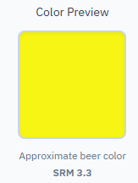
Putting It Together- Modern West Coast IPA Example
OG: 14.7
FG: 1.7
ABV: 7.0%
IBU: 68.0
SRM: 3.3
Grain Bill: Pilsner, Dextrose, Extra Pale Wheat
Hops: Mosaic, Mosaic Cryo, Mosaid Dynaboost, Nelson Sauvin, Nelson Sauvin Cryo, Strata, Simcoe CO2 Extract
Yeast: Chico Ale

Slide 32
Putting It Together- Modern West Coast IPA Example

Slide 33
Mash & Lauter
Mash/ Lauter
  Single Infusion: 148F 40-60 Min- Ensures Full Attenuation
  Step: 144F Mash In; 148F 30 Min; 154F 10 Min; 170F Mash Out.
      Still ensures full attenuation, potentially maximizes extract and preserves some mouthfeel.
  1.6 qt/lb Liquor to Grist Ratio
    Medium to Thin to ensure temp stability and enzyme efficiency.
  Mash pH 5.3
    Optimal enzyme efficiency, minimizes tannin extraction, helps with protein coagulation which will improve clarity.
  Target a minimum Calcium addition of 100-150 ppm, favor Calcium Sulfate
    Chloride: Sulfate Ratio between 1.0:1.5- 1.0:3.0 depending on recipe variables and water profile.
    This is crucial for pH control, yeast health/ performance, flavor/ sensory impact, and packaged beer stability.
    Adjust both the mash water and sparge water accordingly
  Cut runoff at or below 5.8 pH/ at or above 2.5oP
    Avoids pulling tannins from the grain

Slide 34
Boil & Whirlpool
Boil
  60 Min Boil- Long enough to drive off DMSP, not too long to drive excess color. Can increase 10-15 Min if needed before seeing excessive color pick up. Boil <75 Minutes if possible.
  Split additions CO2 Extract throughout boil, favoring later additions. Firm Clean Bitterness. If unable to use extract- seek low co-humulone hops
  Dextrose Addition- Increases attenuation, lowers color and malt flavor impact. Helps hops Pop
  Yest Nutrient Addition- Promotes a clean, healthy fermentation
  Kettle Fining Addition- Improves trub compaction and helps HMW Proteins drop out of suspension. Leading to better yields and improved beer flavor and clarity.
Whirlpool
  Cool to below 180F- This will help preserve volatile oils and minimize bitterness pick up. Utilize multiple hop formats and varieties to create layering and promote maximum impact on the finished beer.
    EX: Hot Side Flowable, T-90, and Cryo Hops
  Target 1.0#/BBL or greater total hop addition, Utilize advanced hop products to minimize wort loss.
  Reduce knockout pH to 5.1, this will also help with protein coagulation and to better hit final beer pH target.

Slide 35
Knockout & Fermentation
Knockout
  Target 8-10 ppm of DO for Cal Ale, adjust depending on yeast strain, generation, etc
  Optional- Add a Chill Haze reducing enzyme such as Clarex to further prevent chill haze
  Optional- Add ALDC enzyme to aid in diacetyl prevention
    **This is a great tool, but it should not be a substitute for poor brewing practices/ yeast management
Fermentation
  Set tank to desired temp, preferably on the lower end of the range for 48 hours.
    This will help reduce the creation of off flavors and esters.
  After Day 2, raise the tank temp by an additional 2F. After Day 4, raise the temp an additional 2-4F for a Diacetyl Rest
  Perform a VDK test to ensure Diacetyl has been reduced. Targeting a 10-day fermentation.
  Harvest or dump yeast
  Adjust the pH before dry hopping to APPX 4.3

Slide 36
Dry Hop
Dry hop in 2 stages to maximize hop expression and get the best out of various varieties and products. Target 3.0+ #/BBL Total
Total contact time should be 1-2 days max on the hops per addition.
Add ALDC at Dry Hop to help manage diacetyl increase if needed.
Dry Hop #1:
  After passing VDK, perform Dry Hop #1. This is a great time to add higher oil or “danker” varieties and products such as Cryo, Cold Side Flowable, and more classic leaning hops.
  Typically, ¼-1/2 the total dry hop volume
  Add the hops at the end of the day, come in in the AM, pressurize the tank to APPX 15 PSI. This will encourage the hops to incorporate and preserve aroma.
  After 24-48ish hours, dump hops and trub/ yeast.
Dry Hop #2:
  Depending on preference- dry hop again at the same temp, or cool APPX 10F before adding additional hops. Perform same steps as first dry hop.
    Cooler temp can showcase truer hop flavor/ aroma to the variety and lot.
Depending on your available hops, pellet density, and preferences adjust as needed. Add a dry hop during fermentation, change it all to one dry hop, dry hop twice warm. Etc.

Slide 37
Conditioning & Packaging
After dry hopping is complete, dose ½ the Biofine volume and crash tank to 33F, hold for 24-48 hours and drop trub each day 1-2 times.
Purge BBT and dose second half of Biofine, or add inline during transfer.
  **It is best to run benchtop trials to optimize biofine rates and timing. Less is better for minimizing hop aroma/flavor impact. That being said, clarity is important to nailing this style.
Centrifuge if desired
Transfer to BBT and hold for 24 hours
Carbonate between 2.6-2.8 vol. CO2- will depend on final gravity and BU’s

Slide 38
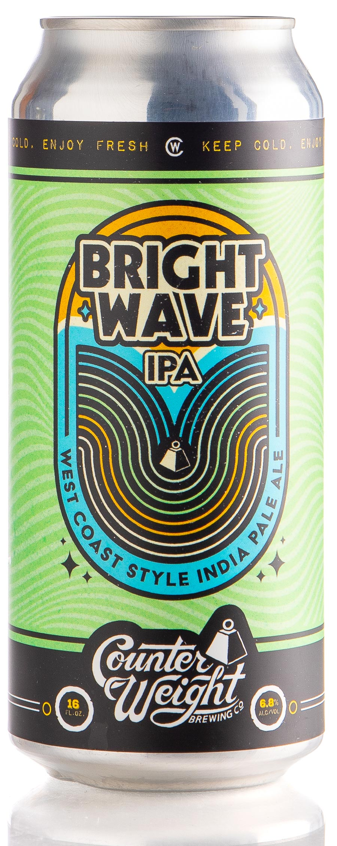
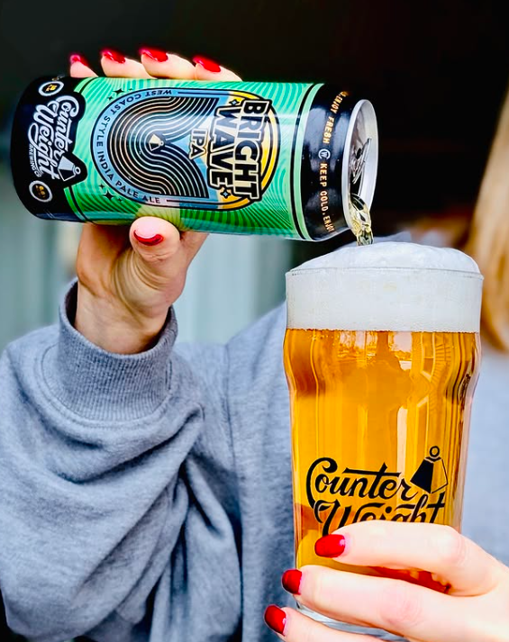
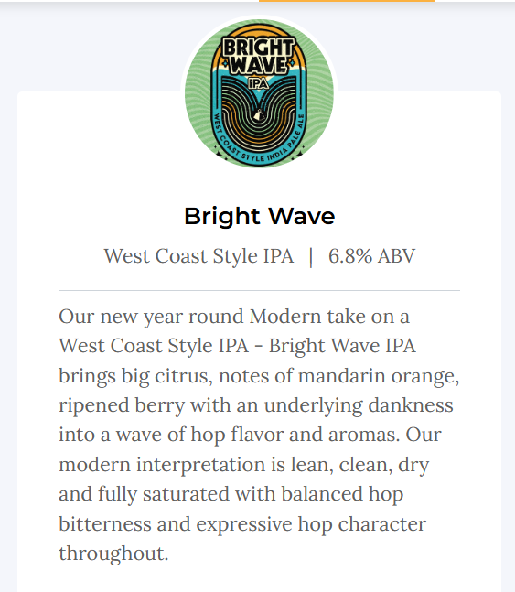
Last step… Enjoy!

Slide 39

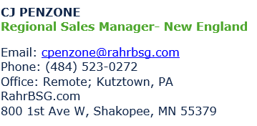
THANK YOU

